Slide 1
Revised Curriculum

Slide 2
Intentions
Why
Why is the curriculum changing?
Why now?
What
What does the revised curriculum look like?
Where can I find it?
What does this look like?
How
How is the curriculum revision process happening?
What is the Ministry of Education doing?
What is School District 57 doing?

Slide 3
Why? What did educators say about the current curriculum?
https://www.bced.gov.bc.ca/irp/docs/overview.pdf
highly prescriptive nature-
at odds with the vision of a more personalized learning experience set out in BC’s Education Plan.
too many objectives to cover and with so many objectives it can in some ways restrict student learning.
students have virtually instant access to a limitless amount of information. -greater value of education for every student is not in learning the information but in learning the skills they need to successfully find, consume, think about and apply it in their lives.
focus on teaching children factual content rather than concepts and processes – emphasizing what they learn over how they learn, opposite of what modern education should strive to do.

Slide 4
Guiding Principles for Future Curriculum Development
Make curriculum more flexible to better enable teachers to innovate and personalize learning.
Reduce the prescriptive nature of current curricula while ensuring a solid focus on essential learning.
Focus new curricula on higher order learning, giving emphasis to the key concepts and enduring understandings (big ideas) that students need to succeed in their education and their lives.
Make explicit the cross-curricular competencies that support life-long learning.
Respect the inherent logic and unique nature of the disciplines while supporting efforts to develop cross-curricular units.
Integrate Aboriginal worldviews and knowledge.
Develop assessment and evaluation programs that align with the changed emphases in curriculum.
https://curriculum.gov.bc.ca/assessment-info

Slide 5
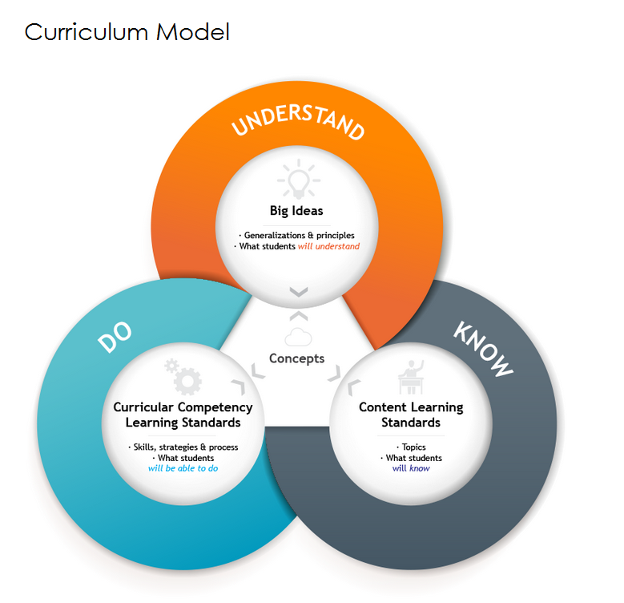
What
https://curriculum.gov.bc.ca/curriculum-info

Slide 6
Key Features of the Curriculum
Core Competencies
Communicating
Thinking
Personal and Social Competency
Literacy and Math Skills Foundations
Content (Know)
Curricular Competencies (DO)

Slide 7
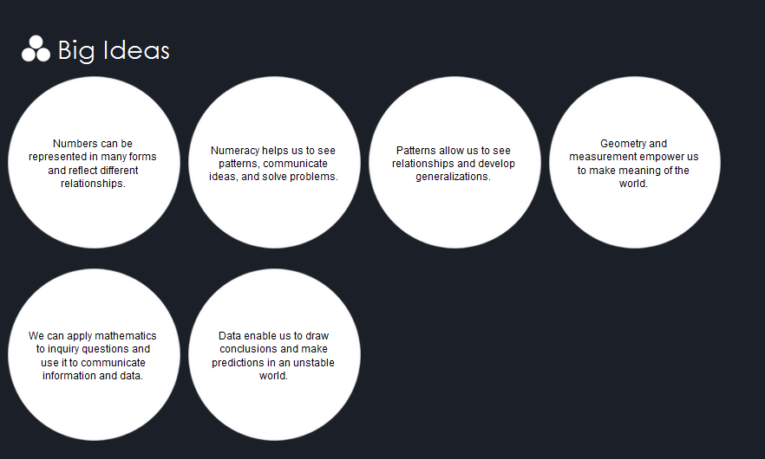
Big Ideas (Understand)
What’s the Same, Different?
Same | Different
Continue to be rigorous learning standards | All areas being redesigned using a common framework
Continued emphasis in all grades – literacy and numeracy | Structure is more flexible to enable cross-curricular learning
Graduation – 80 credits still required | Core Competencies
Math, Science, Language Arts, Social Studies, etc | Model- Know- Do-Understand
 | Standards remain rigorous- but open in nature, less rigid
 | Aboriginal perspective and content have been authentically integrated into every subject
 | New Career Education and Applied Design, Skills and Technologies https://curriculum.gov.bc.ca/sites/curriculum.gov.bc.ca/files/pdf/faq.pdf

Slide 8
Access to the Curriculum
https://curriculum.gov.bc.ca/

Slide 9
Resources to Support

Slide 10
Assessment
Assessment and Curriculum are interconnected
Assessments will continue to be rigorous and based on learning standards evaluating:
student achievement
core competencies
essential learning
literacy and numeracy

Slide 11
https://curriculum.gov.bc.ca/assessment-info

Slide 12
Changes to Provincial Assessments
Grade 10-12
Students will complete 2 provincial assessments focused on literacy and math skills
Change from 5 provincial exams
Provincial exams for Science 10, Socials 11, English 10 and Math 10 will not longer be used
Emphasis will be on application of learning
Greater focus on classroom assessment
Grades 4 and 7
Field testing of a new assessment will begin this fall
FSA will continue for this year
https://curriculum.gov.bc.ca/assessment-info

Slide 13
Graduation
https://curriculum.gov.bc.ca/graduation-info#grad-table

Slide 14
Communicating Student Learning

Slide 15
Communicating Student Learning- Ministry Update
K-9
New Reporting Order in Effect
Provides options for districts as they implement redesigned and new curriculum
10-12
No changes this year
Working groups with stakeholders and subject matter experts to develop new policy

Slide 16
Policy statement
Boards of Education must provide parents of students with a minimum of five reports describing students' school progress. Reporting to parents should be timely and responsive throughout the school year.
For Grades K-9 beginning in the 2016/17 school year, Boards of Education will either
A. Develop and follow local student reporting policy and procedures set by the Board for Grades K-9, which must meet the Interim Student Reporting Guidelines for Grades K-9 as outlined below,
or B. Follow the revised Student Reporting Policy as outlined below.
(For Grades 10-12, Boards will follow the Student Reporting Policy.)

Slide 17
Rationale
The Ministry of Education is redesigning curriculum and assessment to fit with the modern education system needed for today’s world. Redesigned curriculum for Grades K-9 is being implemented in the 2016/2017 school year. In addition, parental engagement about student progress reporting is taking place during the 2016/17 school year.
To provide flexibility beginning in the 2016/2017 school year, Boards of Education that have developed or are developing new student progress reporting policies and procedures for students in Grades K-9 may use these practices if they meet the Interim Student Reporting Guidelines contained in this policy.

Slide 18
Reporting Student Learning- District Update
Changes made for this year:
Grades K-7 will see changes as per the interim reporting guidelines from the Ministry of Education
Grades 8-9 will follow the Revised Student Reporting Policy
Grades 10-12 the interim reporting guidelines do not apply
Reporting needs to include a summative student self assessment on Core Competencies
Reporting needs to include Applied Skills Design Technology and Career Education

Slide 19
Reporting Student Learning- District Update
Report Writer WILL NOT be used, new report card will be developed
Teacher should continue to utilize assessment practises outlined in the Principles of Quality Assessment information provided by the Ministry of Education
We continue to work with Ministry, and neighboring districts to outline School District No.57’s reporting requirements
A committee consisting of teachers, principals, parent, student will be created to help inform reporting formats

Slide 20
Communicating Student Learning
Moving from communicating student learning as an Event ( Reporting) …
……….to Communicating Student Learning as ongoing, timely and responsive
Traditional Reporting
Communicating Student Learning
Formal and informal
One way Communication
Set times of the year, 3 terms (may not always align with what is happening in the classroom)
Once size fits all approach
Ongoing and responsive to learning throughout the year
3 way communication (parent, student and teacher)
More individualize towards student and classroom teacher
What is the Same..
Communication at least 5 times a year
Communicating learning in relation to the learning standards in the BC Curriculum
Information about child’s work habits and attitude towards learning
Written information about child’s learning progress

Slide 21
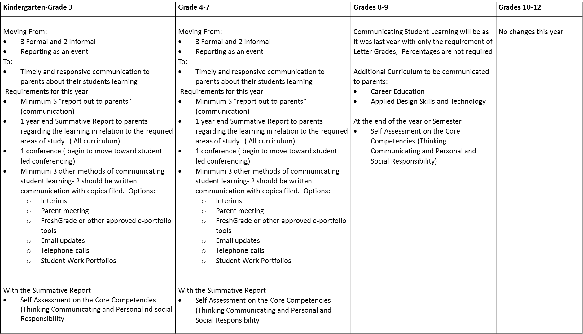
Communicating Student Learning District Plan

Slide 22
How
Ministry Timeline

Slide 23
SD57 Timeline of Events
2013/14
Graduation Dialogue
Community Event
Draft Curriculum Review k-9
Ministry Selected Team to develop Communication Competency
develop strategy to support teachers with implementation of BC ed plan
2014/15
Support teachers with the planning for new curriculum (LTGs, pilots etc)

Slide 24
2015/16
Develop Curriculum Implementation Advisory Committee
Grade 10-12 Draft Curriculum Review
staff and community presentations on Curriculum Website
develop and plan 2 additional NID days to support the revised curriculum
create supports for implementation for the next 2 years
develop innovation grants for staff to start working together in collaborative teams

Slide 25
2016/17
Develop Communicating Student Learning Advisory Committee
Transition Communicating Student learning
Grade 10-12 Draft Curriculum Trial
Develop and plan 1 additional NID days to support the revised curriculum
Set up existing Pro D days to support curriculum implementation
Utilize supports (curriculum coaches) for implementation for the next 2 years
Support innovation grants for staff to start working together in collaborative teams

Slide 26
Educated Citizen
https://curriculum.gov.bc.ca/sites/curriculum.gov.bc.ca/files/pdf/curriculum_intro.pdf
Thoughtful and able to learn and think critically , can communicate information from a broad knowledge base
Aware of the rights of the individual and are prepared toe exercise the responsibilities of the individual with the family, the community, Canada and the world
Are creative, flexible and self-motivated , have a positive self image
Are skilled and able to contribute to society generally, including the world of work
Are productive, gain satisfaction through achievement, strive fore physical well-being
Are cooperative, principled, and respectful of other regardless of differences
Are capable of making independent decisions

Slide 27
Questions..
Cindy Heitman
District Principal Learning Innovations
School District 57
250-561-6800 ext 311
cheitman@sd57.bc.ca

